Slide 1
GatHors – Image Processing in Hadoop
Yilun Chen
Xiang Zhang
Peng Huang

Slide 2
Outline
Motivation
Overall Architecture
Brief Introduction to Algorithms
Implementation
  Frontend
  Preprocessing
  Core work
  Postprocessing
Performance & Evaluation
Conclusion

Slide 3
Motivation
1. Pictures Recognition become popular and useful
2. Imagine processing is more complex and time-costly than processing text
3. The growing size of datasets need programs have high-throughput, high-scalability.
4. Traditional ways method do not support image extracting from videos and preprocess images before runtime execuation

Slide 4
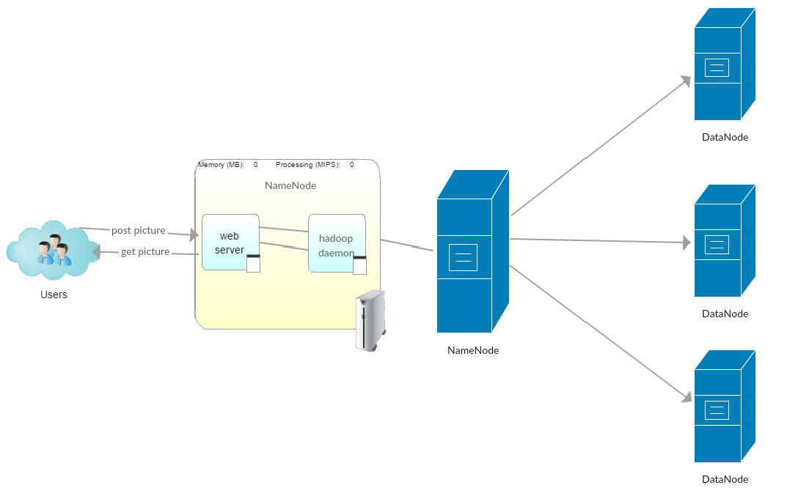
II. Architecture

Slide 5
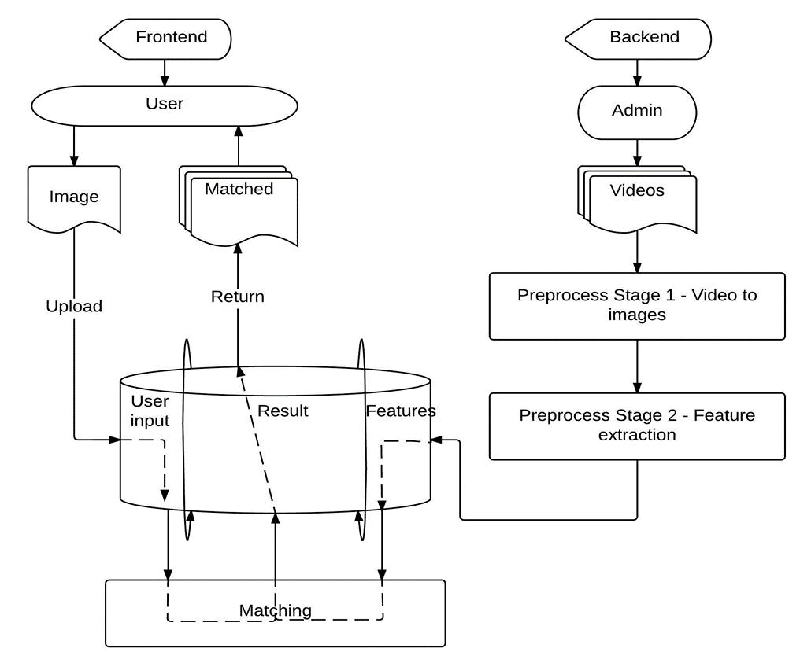
II. Architecture

Slide 6
III. Frontend web server
Developed in JSP/Servlet framework
Installed Apache Tomcat in google cloud
Deployed web server in hadoop namenode

Slide 7
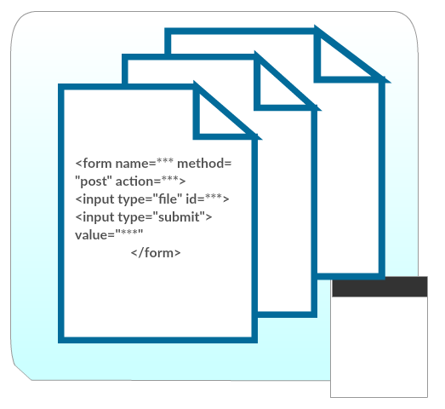
III. Frontend web server
Receive requested data from users

Slide 8
III. Frontend web server
Launch feature matching program to distributed comparing features from user request
Wait for matching program finishing
Forward and display final results

Slide 9
Brief Introduction to Algorithms
SIFT
HSV based color histogram

Slide 10
Brief Introduction to Algorithms
  Scale-space extreme detection
  Key point Localization
  Orientation Assignment
  Key point descriptor

Slide 11
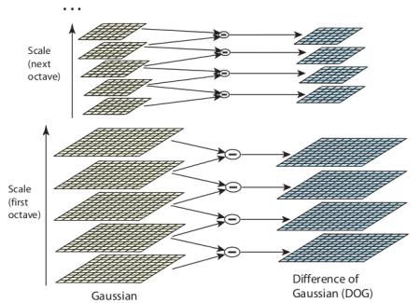
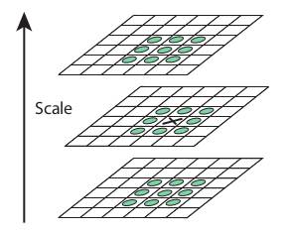
Brief Introduction to Algorithms

Slide 12
Brief Introduction to Algorithms
  In this step it will remove the unstable key point candidates to get more accurate results.
  1. If the intensity at this extrema is less than a threshold (usually 0.03) , it is rejected.
  2. DoG has high response for edges, so edges also need to be removed.

Slide 13

Brief Introduction to Algorithms
In this step, each key point is assigned one or more orientations based on local image gradient directions. This is the important step in achieving invariance to rotation, because the key point descriptor can be represented relative to this orientation so the rotation invariance is fulfilled.
The gradient magnitude m(x,y) and orientation $θ\left(x,y\right)$ of blurred image L(x, y,$σ$) can be computed with adjacent pixel:
$$m\left(x,y\right)=\sqrt{{(L\left(x+1,y\right)−L\left(x−1,y\right))}^{2}+{(L\left(x,y+1\right)−L\left(x,y−1\right))}^{2}}$$
$$θ\left(x,y\right)=atan2(L\left(x,y+1\right)−L\left(x,y−1\right),L\left(x+1,y\right)−L\left(x−1,y\right))$$
Thus each key point will have three kinds of information: location, scale and one or multiple orientations.

Slide 14
Brief Introduction to Algorithms
Keypoint descriptor
  Add one more vector to key point to keep the invariance of illumination and different views. Create the key point descriptor.
  After four steps, we can determine the similarity of two objects by computing the Euclidean distance of key points between two images.
  The ratio of closest-distance to second-closest distance is taken. If they are greater than a specific threshold( usually 0.8 ), then they are rejected. Because in some cases, the second closest-match may be very near to the first due to noise or other reasons.

Slide 15
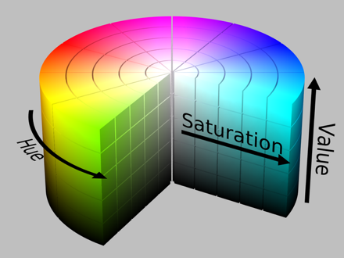
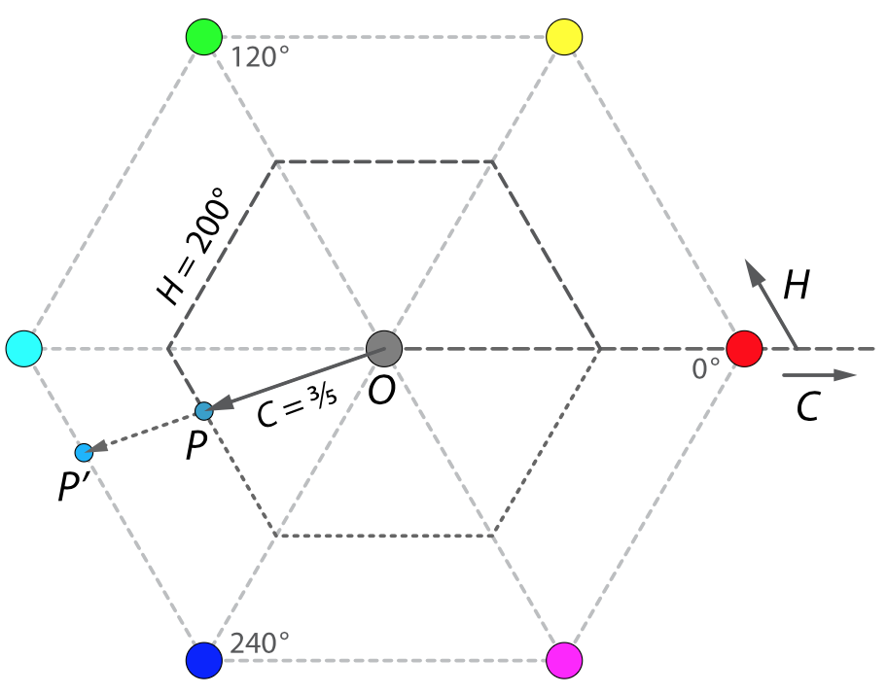
Brief Introduction to Algorithms

Slide 16
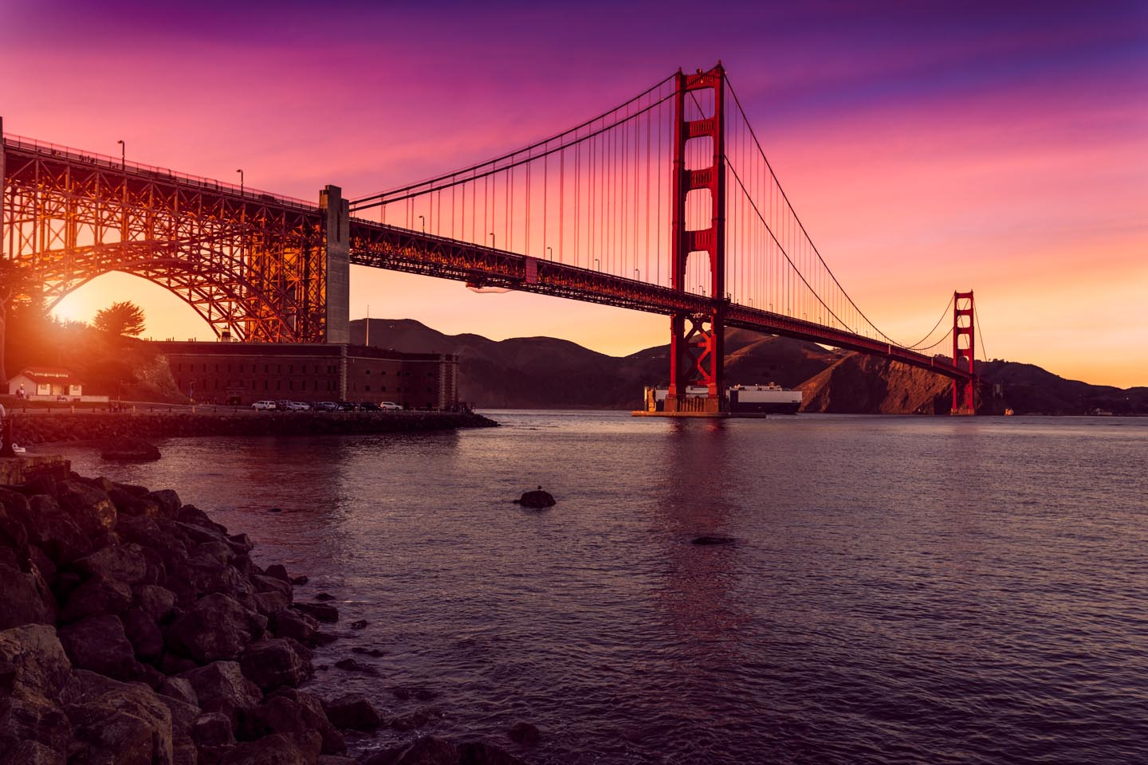
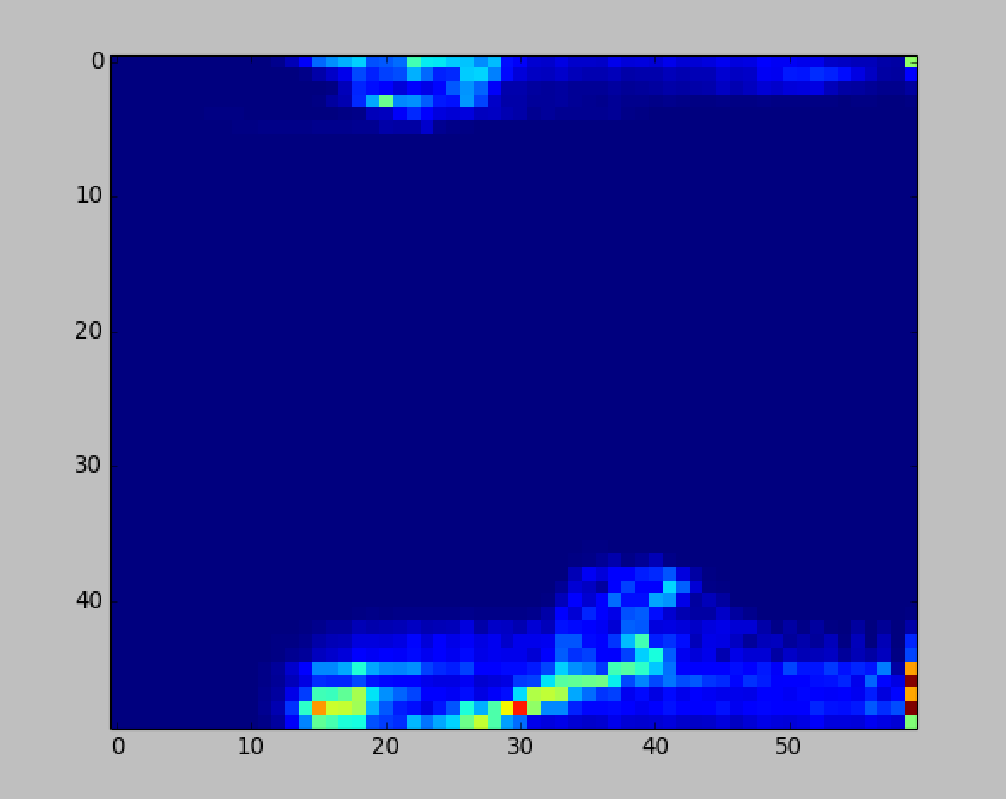
Brief Introduction to Algorithms
A color histogram of an image stands for the distribution of the composition of colors in the image. It shows different colors that are appeared and the number of pixels in each type of the colors that are appeared.

Slide 17

Brief Introduction to Algorithms
To determine whether two images are similar, we will use compute the correlation between corresponding histograms.
$$d\left(H_{1},H_{2}\right)=\frac{\sum_{I}{(}H_{1}\left(I\right)−\overline{H_{1}})(H_{2}\left(I\right)−\overline{H_{2}})}{\sqrt{\sum_{I}{{(H_{1}\left(I\right)−\overline{H_{1}})}^{2}}\sum_{I}{{(H_{2}\left(I\right)−\overline{H_{2}})}^{2}}}}$$
where
$$\overline{H_{k}}=\frac{1}{N}\sum_{J}{H_{k}(J)}$$
and N is total number of histogram bins.

Slide 18
Implementation
Preprocessing Stage 1 – FrameExtraction
Non distributed processing
Vide to frames

Slide 19
Preprocessing Stage 1 – FrameExtraction
ffmpeg
Video
ffmpeg
frames
Notes:
1. For now, we only have the input directory under this folder since we only need somewhere to temporarily store the HipiImageBundle file as input.

Slide 20
Implementation
Preprocessing Stage 2 – FeatureExtraction
Distributed Data Storage
Float image to OpenCV Mat
Feature Extraction

Slide 21
Preprocessing Stage 2 – FeatureExtraction
Distributed Data Storage
Admin directory
  This is the main directory for administration. All the administering concerned information are stored under this folder.
Feature directory
  This is where we store the features extracted by SIFT.
User
  Input
  Output
Notes:
1. For now, we only have the input directory under this folder since we only need somewhere to temporarily store the HipiImageBundle file as input.

Slide 22
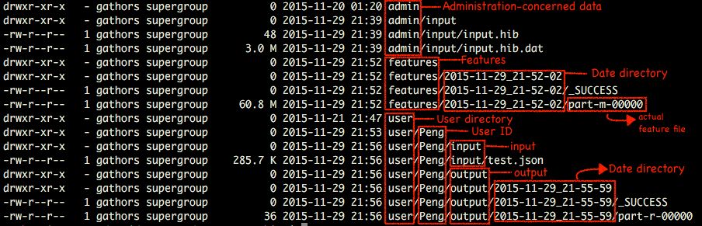
Preprocessing Stage 2 – FeatureExtraction
Distributed Data Storage

Slide 23
Preprocessing Stage 2 – FeatureExtraction
Float Image to OpenCV Mat
Images we have now
  HipiImage (FloatImage)
Images we need
  Mat (the basic data type in OpenCV)
Transform
  Scan the whole pixel array of a image, and put them into Mat in the “RGB” sequence according to their specific positions.

Slide 24
Preprocessing Stage 2 – FeatureExtraction
Feature Extraction
Keypoints
  SIFT Feature Detector
  A list of positions of keypoints
Extract
  SIFT Feature Extractor
  Calculation the value of keypoints specified by keypionts
Storing Mat to HDFS
  Features are needed in every map task. So it should be available to all mappers.
  Transfrom the Mat to JSON-type string.

Slide 25
Core work – Feature Matching
Query image feature extraction
  Extract the feature(Mat) from the input jps
  Store the feature(Mat) to HDFS
Mapping
  Fetch the feature(JSON) from database
  Transform feature(JSON) to feature(Mat)
  Match using FLANNEDBASED Descriptor Matcher
  Calculate the ratio of good matches
Reducing
  Collect all matched results generated by Mapping
  Output to xxx/user/output/

Slide 26
C. Postprocessing – Result Refinement
Filter — To avoid returning extremely similar result to customers
Method: HSV based histogram conparison
Threshold: 0.8

Slide 27
Performance & Evaluation
Arguments for testing accuracy:
  Distance threshold factor
  Ratio threshold
Results
Ratio threshold
Notes:
1. We can see from the Fig.XXX, the larger distance threshold factor we set, the higher ratio of matches we can get. When the threshold is above the 50%, the matched ratio increases dramatically. With the ratio threshold set to 20%, the distance threshold factor of 60% will even give out the result that all images are matched.

Slide 28
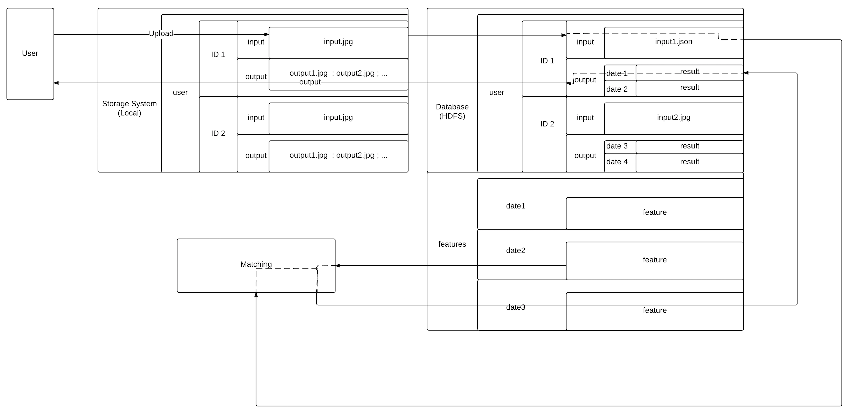
1
2
1

